Slide 1





WP3
INSPIRE Practical Handbook
Chapter 3
Sustainability in the Performing arts

Slide 2

Lesson 1:
Sustainability: Principles, Evolution and Cultural Relevance

Slide 3
Fundamentals of Sustainability
What is Sustainability? – Sustainability is defined as the ability to preserve natural resources and maintain an appropriate balance between human needs and environmental protection.
When did the concept of sustainability emerge? – The concept of sustainability was consolidated in 1987 with the publication of the Brundtland Report, officially titled Our Common Future, produced by the World Commission on Environment and Development. This influential document introduced the notion of sustainable development, often used synonymously with sustainability, and laid the theoretical foundations for modern environmental and social responsibility.
Notes:
Sustainability: This concept implies that human activities should be carried out responsibly to ensure that both present and future generations can enjoy a healthy environment.
The adoption of sustainable practices is vital to ensure a viable future, preventing resource depletion and minimising the negative impact on nature.
Beyond the environmental aspect, sustainability encompasses social (equity, inclusion, community well-being) and economic (long-term financial viability) dimensions.

Slide 4
Fundamentals of Sustainability
Sustainable development – Development that meets the needs of the present without compromising the ability of future generations to meet their own needs.
This approach highlights the importance of balancing natural resource use with human needs, within a framework of intergenerational justice.
Sustainability seeks to: (a) Harmonise economic growth; (b) Protecting the environment; (c) Promote social well-being
Sustainable development involves: (a) Intergenerational equity; (b) Integration of dimensions; (c) Caution and responsibility.
Notes:
Take a look at the original document: Brundtland Report – Our Common Future (1987)
To fully understand the concept of sustainable development, it is essential to recognise that it is based on the intersection of three key and interdependent pillars: the environmental pillar, the social pillar, and the economic pillar.

Slide 5
The Triple Bottom Line (TBL)
Balances three essential pillars:
Care for the planet (Environmental)
Well-being of people (Social)
Economic viability of organisations (Economic)
Widely used sustainability strategy across sectors
In performing arts: incomplete without Cultural dimension
Culture’s role: Values, traditions & artistic expression shape environmental & economic practices

Slide 6
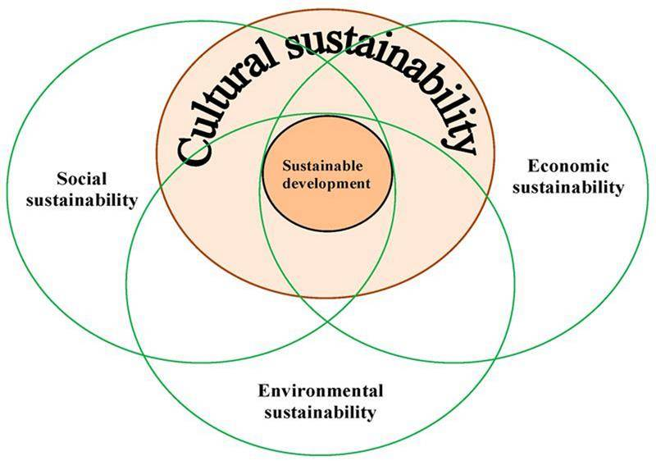
Integrating the Pillars
Pillars must be integrated, not isolated
Sustainable development = complex & involves trade-offs
Performing arts challenges: Social impact & economic precariousness often outweigh environmental priorities in short term

Slide 7
Environmental Pillar
Focus: Conserve & use natural resources responsibly
Protect ecosystems, reduce carbon footprint, manage waste, promote renewable energy
Performing arts application: Resource conservation & energy efficiency in production
Key impacts
• Biodiversity conservation through responsible selection of materials.
• Emission reduction and efficient waste management.
• Promoting sustainable mobility extended to touring, audience travel and artist travel.
• Use of renewable energies - Promoting principals of the circular economy

Slide 8
Social Pillar
Focus: Equity, inclusion & community well-being
Support human rights, equitable access to resources, education, health,
decent working conditions
Performing arts application: Foster inclusion & diversity, ensure fair work conditions
Key impacts:
• Fair and decent working conditions.
• Diversity and inclusion in the team and on stage.
• Cultural access for all audiences.

Slide 9
Economic Pillar
Focus: Long-term financial sustainability without harming ecosystems
Promote ethical, responsible decisions with transparency & accountability
Performing arts application:
o Sustainable business models o Resource efficiency & circular economy
o Internalise environmental costs
Key impacts:
• Creating sustainable and resilient business models; •Transparency and ethics in management;
• Resource optimisation and cost reduction

Slide 10
Beyond TBL – ESG Model
E: Environmental – manage environmental footprint
S: Social – promote responsibility & inclusion
G: Governance – ensure transparency & ethics
Origin: corporate & investment sector → now used in public & non-profit sectors
Relevance: Helps cultural entities operate responsibly & secure long-term support

Slide 11
Cultural Dimension
Role: Art educates, inspires & transforms society
In performing arts: catalyst for awareness & sustainable change
Key impacts:
• Promote cultural diversity and preservation of heritage.
• Promote social reflection through art.
• Fostering inclusion

Slide 12
History & Evolution of Sustainability
Overview of major global milestones shaping sustainability concepts
From first environmental conferences to modern corporate and cultural frameworks
Purpose: Encourage reflection on how each decade influenced artistic practices, funding, audience engagement & infrastructure

Slide 13
1970s
Stockholm Conference on the Human Environment – first global event on sustainability
Birth of sustainable development concept
Brundtland Report: “Meeting the needs of the present without compromising the ability of future generations to meet their own needs”
1980s

Slide 14
1990s
Earth Summit (Rio de Janeiro) – Agenda 21: first global action plan for sustainable development, where principles of sustainability are integrated sustainability into public policies
Kyoto Protocol – first binding agreement to reduce GHG emission

Slide 15
2000s
Millennium Summit – Millennium Development Goals (MDGs) for 2015: poverty reduction, health, education, gender equality, environment
Circular Economy concept formalised
Corporate Social Responsibility (CSR) emerges as business sustainability key
UNESCO Convention links cultural diversity & sustainable development
Carbon footprint concept consolidated

Slide 16
2010s
ISO 26000: Social Responsibility Standard – International standard that guides organisations in sustainable practices.
2012 United Nations Conference on Sustainable Development, Rio de Janeiro – launched process for Sustainable Development Goals (SDGs), build on MDGs to address broader sustainability challenges.

Slide 17
2015s
Paris Agreement (COP21) – “Net Zero emissions” target by 2050. Limit warming to 1.5ºC
Sustainable Development Summit – launched 2030 Agenda with 17 SDGs & 169 targets
European Green Deal – EU strategy for climate neutrality by 2050

Slide 18
2020s
Theatre Green Book – carbon neutrality guidelines for entertainment industry
Ultimate Cookbook for Cultural Managers – practical sustainability strategies for performing arts
CSRD (Corporate Sustainability Reporting Directive) – EU reporting rules for large companies & creative sectors
ISO 20121 updated – event sustainability standards for theatres, festivals, touring & live event organisations

Slide 19
Sustainability in the Performing Arts
Performing arts can drive sustainable change through:
o Recycled scenography & second-hand costumes
o Low-impact touring models
o Collaborative, adaptive creative processes as a natural sustainability model
Shared purpose boosts team motivation, environmental connection & community impact
Arts don’t just represent change, they activate it

Slide 20
Key Challenges
Balancing sustainability with economic viability
Turning values into measurable outcomes (indicators)
Connecting sustainability with inclusion and social justice
Integrating sustainability into productions and buildings
Innovating without losing artistic identity
Supporting younger generations in the transition
Fostering a sustainable organisational culture

Slide 21
Sector Barriers
• Disposable and short-lived set designs
• Lack of sustainable planning from the outset
• Resistance to change within artistic or technical teams
• Limited knowledge of how to measure environmental impact
• Old theatres lacking energy efficiency
• Complex operations and limited resources
• Few incentives to adopt sustainable practices

Slide 22
Practical Solutions
Funding calls with environmental criteria (e.g. Arts Council England)
Reusable set designs (e.g. Théâtre Vidy-Lausanne)
Sustainability training for staff (e.g. NTGent)
Application of international tools and guidance
Optimising Resources for a Sustainable Stage
Local & sustainable suppliers to cut transport emissions
Digital tools for measurement (e.g. Julie’s Bicycle carbon calculators)

Slide 23
Opportunities for the Sector
Green practices - recyclable materials, energy efficiency, waste management
Digitalisation – digital technologies in productions, communication and collaboration tools
Community engagement - partnerships fostering inclusion, and supporting local initiatives
Training & education - specialised programmes for knowledge and skills
Result: Enhanced environmental responsibility, creativity & economic resilience

Slide 24

Lesson 2: Frameworks, Models and International Standards for Sustainability

Slide 25
What Are Global Policies?
Commitments by governments & international bodies guiding global sustainability actions
Usually broad, strategic frameworks rather than binding laws
Influence creation of norms & agreements
Examples: emissions reduction, sustainable development goal

Slide 26
Paris Agreement (2015)
Global pact to limit global warming to 1.5°C
Reduce greenhouse gas emissions
Performing arts application:
- Adopting measures to decrease carbon footprint
- improving waste management
- reducing mobility impacts
- incorporating recyclable materials

Slide 27
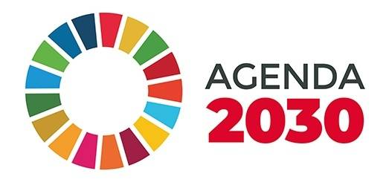
Agenda 2030 & the SDGs
Adopted in 2015 by all 193 UN member countries
Vision: People, planet, prosperity, peace
17 Sustainable Development Goals & 169 targets (economic, social, environmental) to be achieved by 2030
Addresses poverty, inequality, climate change, environmental
degradation, gender injusti

Slide 28
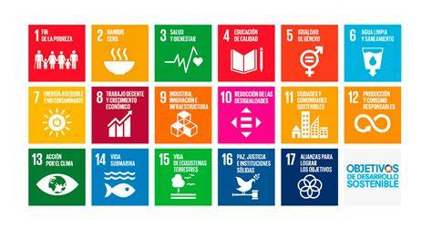
Agenda 2030 & the SDGs
Performing arts role:
- Raise awareness & educate audiences
- Promote social & environmental change
- Examples:
SDG 4 – Quality education; SDG 5 – Gender equality; SDG 7 – Clean energy;
SDG 10 – Reduced inequalities; SDG 12 – Responsible consumption & production
SDG 13 – Climate action

Slide 29
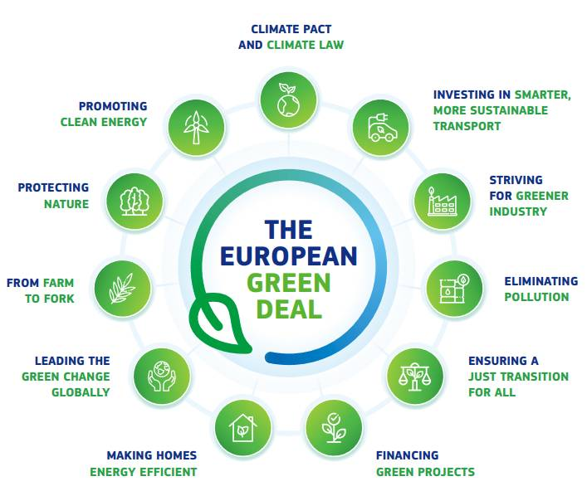
European Green Deal
EU’s roadmap for climate neutrality by 2050
Policies & measures to make Europe first carbon-neutral continent
Includes energy, transport, agriculture & industry reforms
Cultural sector implication: Encourage green production
methods & lower environmental impact of event

Slide 30
What is Legislation?
Mandatory laws and regulations from governments or public institutions (e.g., EU)
Compliance is a legal obligation
Some require certification by an accredited body
Why It Matters to the Arts
Rules can directly affect how organisations operate
Not all apply to every cultural organisation
Applicability depends on:
Type of activity; Size & funding; Number of employees; Other variables
Notes:
The following examples are relevant to the performing arts
Always check specific requirements in your country
Encourage students to see these laws as both obligations and opportunities

Slide 31
Corporate Sustainability Reporting Directive (CSRD)
New EU directive for detailed ESG disclosures, replacing NFRD
Main: ESG impacts, risks, opportunities, double materiality, whole value chain
Impact: Large cultural organisations must report environmental & social impacts, improving transparency
Non-Financial Reporting Directive (NFRD)
Requires large EU companies to report non-financial info
Covers social, environmental, human rights, anti-corruption
Impact: Applies to large/publicly funded cultural entities; forms basis for CSRD

Slide 32
EU Taxonomy
Classification of environmentally sustainable economic activities
Measures proportion of activities aligned with EU environmental objectives
Impact: Helps cultural organisations identify sustainable activities, access green finance
Energy Performance of Buildings Directive (EPBD)
Sets minimum energy performance standards; decarbonise buildings by 2050
Targets worst-performing buildings, phases out fossil fuel boilers by 2040
Impact: Cultural venues may need renovations; funding available but may be challenging

Slide 33
Renewable Energy Directive (RED II)
Promotes renewable energy, self-consumption, energy communities
Allows installation of renewable energy sources (e.g., solar panels)
Impact: Theatres/venues can self-consume, get subsidies, reduce energy impact
Energy Efficiency Directive (EED)
Sets binding targets for reducing energy consumption
Mandatory energy savings, energy audits for large organisations
Impact: Cultural venues advised to carry out energy audits depending on national plans

Slide 34
Ecodesign Regulation for Sustainable Products (ERSP)
Ensures products are sustainable, durable, circular
Includes Digital Product Passport
Impact: Cultural goods (costumes, sets) should meet eco-design criteria
Ecodesign Regulation for Light Sources
Sets energy efficiency requirements for lighting products
Stage/studio lighting often exempt
Impact: Organisations should balance artistic needs with efficiency

Slide 35
Waste Framework Directive
Sets waste hierarchy: prevention, reuse, recycling, disposal
Defines responsibilities including extended producer responsibility
Impact: Encourage reuse, recycling in sets, costumes, production
Single-Use Plastics Directive
Bans or restricts certain single-use plastics
Requires alternative materials, labelling, waste reduction
Impact: Events should remove single-use plastics in catering, packaging

Slide 36
Regulation on Batteries and Waste Batteries
Covers design, collection, recycling, digital passport for batteries
Requires info on recycled content, durability, traceability
Impact: Manage batteries in equipment responsibly
Restriction of Hazardous Substances (RoHS)
Limits use of hazardous substances in electronic equipment
Includes lead, mercury, cadmium, etc.
Impact: Cultural orgs must ensure equipment compliance

Slide 37
Eurovignette Directive
Regulates road charges for heavy-duty vehicles
Charges based on CO₂ emissions, pollution
Impact: Touring companies may face higher costs; cleaner vehicles can reduce fees
EU Emissions Trading System 2 (EU ETS 2)
Carbon pricing scheme for buildings & road transport from 2027
Fuel suppliers buy emission allowances, increasing fossil fuel costs
Impact: Cultural sector may face higher energy & transport costs

Slide 38
Special Note: Small Countries
Recycling rules may be hard to follow in small nations
Some theatre materials can’t be recycled locally
Waste export restrictions limit compliance options
EU Emissions Trading System 2 (EU ETS 2)
Carbon pricing scheme for buildings & road transport from 2027
Fuel suppliers buy emission allowances, increasing fossil fuel costs
Impact: Cultural sector may face higher energy & transport costs

Slide 39
International Standards
Global Reporting Initiative (GRI)
• What is it? Framework for transparent sustainability reporting
• Purpose: Accountability on economic, environmental & social impacts
• Application: Report impacts of festivals, theatres & companies
ISO 14001
• What is it? Environmental management system standard
• Purpose: Systematise environmental management
• Application: Manage environmental practices in cultural venue

Slide 40
International Standards
ISO 20121
• What is it? Sustainable event management system
• Purpose: Ensure events are environmentally & socially responsible
• Application: Organising sustainable festivals & performances
ISO 50001
• What is it? Energy management system
• Purpose: Improve energy efficiency & policy implementation
• Application: Manage venue energy use sustainablyl

Slide 41
International Standards
Eco-Management & Audit Scheme (EMAS)
• What is it? EU scheme to improve environmental performance
• Purpose: Continuous environmental improvement
• Application: Reduce venues’ negative environmental impact
OEKO-TEX
• What is it? Certification for sustainable textiles
• Purpose: Ensure safe, eco-friendly fabrics
• Application: Costumes & set materials in productions

Slide 42
International Standards
B Corp Certification
• What is it? Certification for companies with positive social & environmental impact
• Purpose: Evaluate holistic sustainability performance
• Application: Adopt sustainable business models in the arts
BREEAM & LEED
• What are they? Building sustainability certifications
• Purpose: Reduce footprint, enhance occupant wellbeing
• Application: Eco-friendly design & operation of theatres, museums, cultural ven

Slide 43


Activity C3.A1
Designing Inclusive Audience Actions
Identifying one underrepresented group, designing one inclusive action, and linking it to the global, European, and international sustainability frameworks.
Write a short Inclusive Audience Commitment Statement:
“We commit to increasing audience diversity by [specific goal] through
[key action], aligned with [SDG], [legislation], and [standard].”

Slide 44

Lesson 3: Strategies for Environmental Impact and Reduction in the Performing Arts
Notes:
Exploring strategies to assess and reduce environmental impact in the performing arts.
Introduction to PDCA Cycle and Life Cycle Assessment (LCA).

Slide 45
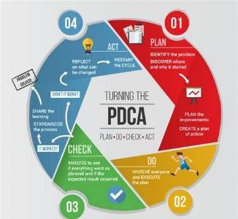
PDCA Cycle
Plan: Identify significant environmental aspects and impacts, set clear objectives, and define specific actions.
Do: Implement the planned processes to comply with
sustainability and regulatory requirements.
Check: Monitor performance through internal audits and
management reviews, ensuring actions are effective.
Act: Take corrective actions and continually improve strategies,
creating a cycle of ongoing sustainability gains.

Slide 46
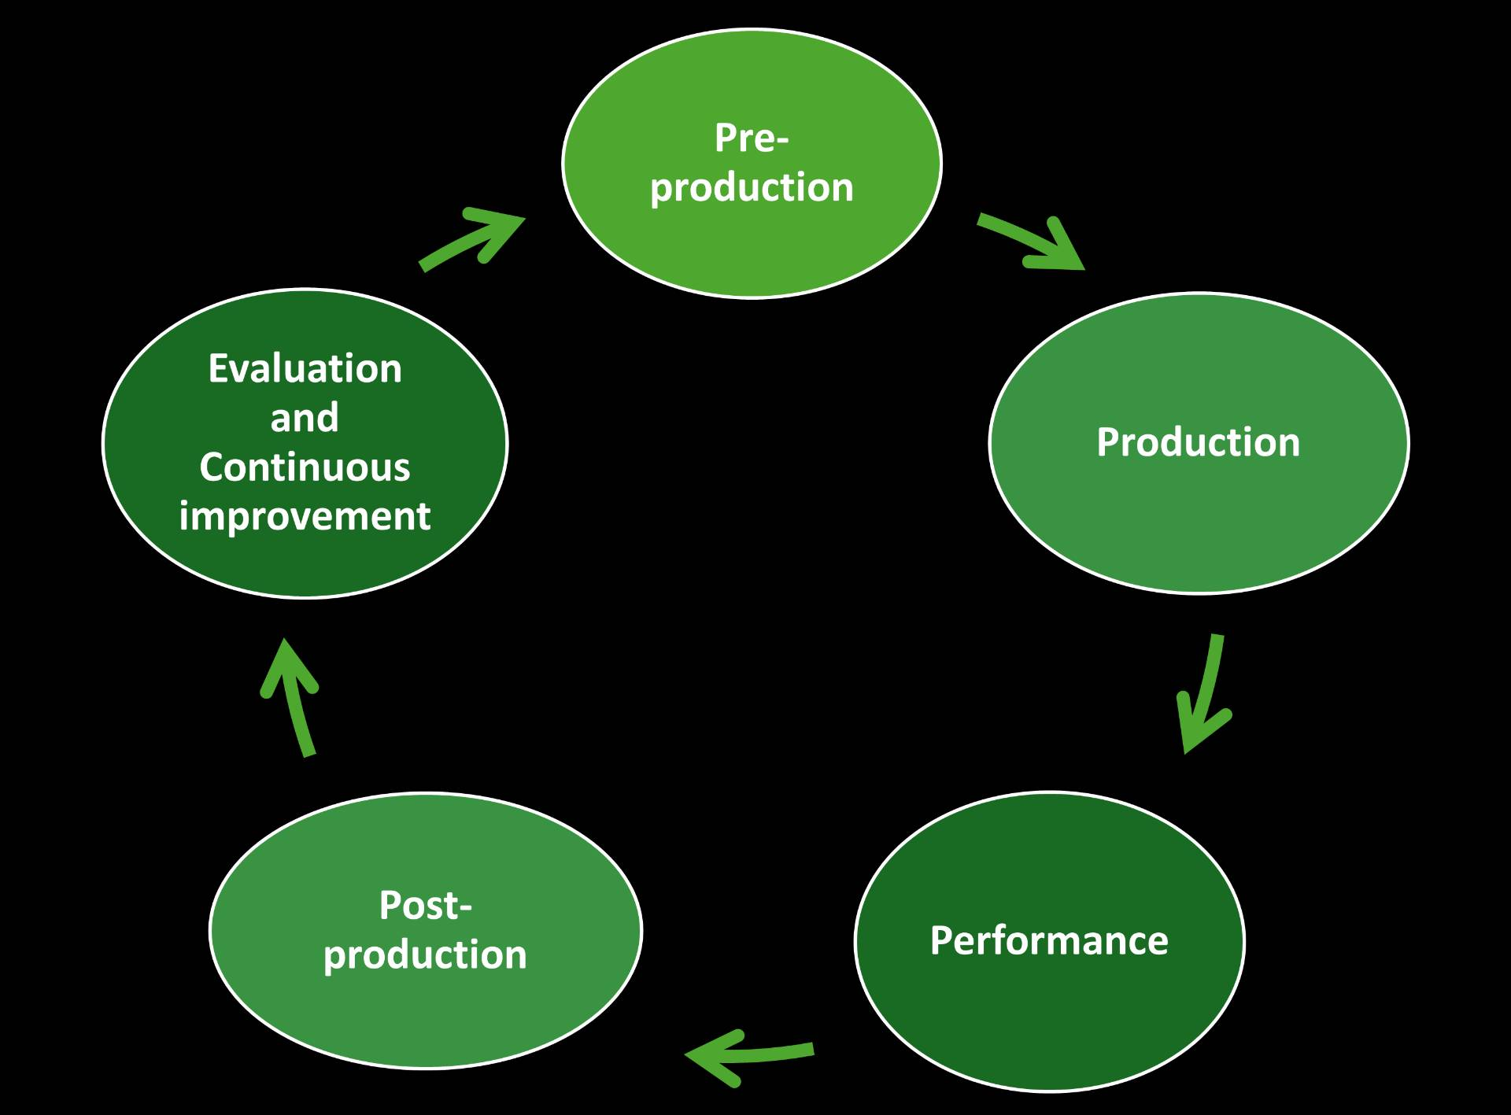
Life Cycle Assessment (LCA)
What is LCA?
• Methodology to evaluate environmental impacts of a product, service, or process across its entire life cycle
• Considers: materials, energy, waste, and emissions
Application in Performing Arts
• Analysis from production to disposal of: Costumes, sets,
props, energy use, waste streams
• Supports sustainable decision-making in theatres, festivals, and companies

Slide 47
Life Cycle Assessment (LCA)
Phases of LCA in the Arts
• Pre-production, sourcing materials, planning
• Production, set building, costumes, energy use
• Performance, venue operations, audience impact
• Post-production, dismantling, recycling, waste handling
• Evaluation & Continuous Improvement, lessons learned, new strategies
Related Assessments
• SEA (Strategic Environmental Assessment) – policies & plans
• EIA (Environmental Impact Assessment) – specific projects

Slide 48
Activity C3.A2
Applying Life Cycle Assessment (LCA) to a Sustainable Training Workshop
Which stage showed the greatest environmental impact in your example?
Which ideas also create social, cultural, or educational benefits (e.g. accessibility, inclusion, awareness, participant engagement)?

Slide 49
Energy Efficiency
Energy efficiency means using the least amount of energy possible without compromising the artistic experience.
Major energy uses in performing arts: house lighting, stage lighting, climate control (HVAC), set production, and audience/staff travel.
Reducing energy consumption lowers costs, improves sustainability, and reduces environmental impact.

Slide 50
Measuring, Analysing, and Optimising Energy Consumption
Data Collection and Measurement: Review energy invoices and contracts, use smart meters to track consumption, and identify hidden energy use to calculate KPIs.
Energy Audit and Diagnosis: Assess building, lighting, HVAC, materials, and transport inefficiencies to pinpoint key energy waste areas.
Developing an Action Plan: Prioritise actions such as upgrading insulation, switching to LEDs, using renewables, modernising HVAC, reusing materials, and promoting low-carbon mobility.

Slide 51
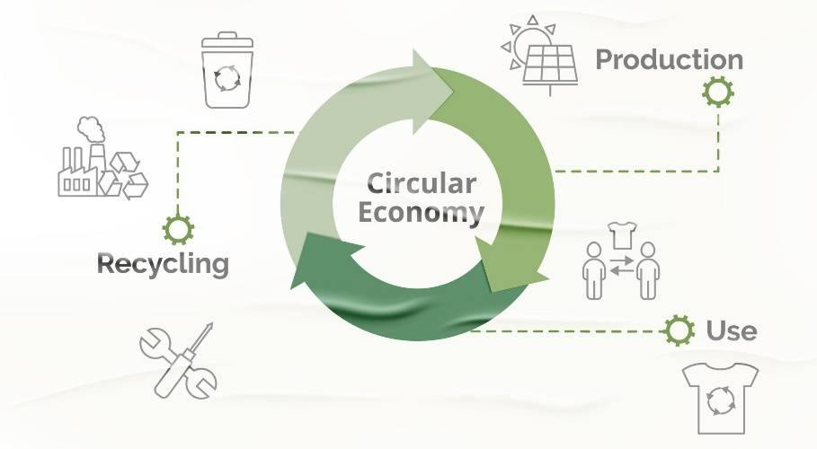
Circular Economy in the Cultural Sector
The circular economy keeps products and materials in use for as long as possible, reducing waste and raw material use.
It replaces the linear 'take–make–dispose' model with strategies such as reuse, repair, recycling, and sustainable design.
In the EU, this model is a priority under
the Circular Economy Action Plan (2020)
aligned with the European Green Deal.

Slide 52
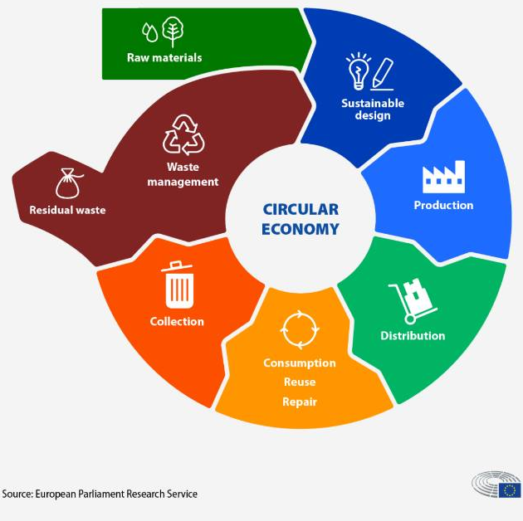
Circular Economy Applications in Performing Arts
Why it matters
• Energy use varies with activities → need a clear baseline.
• Reduces costs + environmental impact.
1. Data Collection & Measurement
• Review invoices & contracts (12+ months).
• Use smart meters (auditorium, rehearsal rooms, HVAC, lighting).
• Identify patterns + hidden energy use.

Slide 53
Circular Economy Applications in Performing Arts
2. Energy Audit & Diagnosis
• Building fabric • Lighting • Travel/transport
• HVAC, modernise, add zoning/ programming - Props/sets
3. Action Plan for Energy Savings
• Upgrade insulation • Install renewable sources
• Switch to LED + motion sensors • Modernise HVAC & optimise usage
• Encourage behaviour changes + green purchasing
• Partner with local suppliers.

Slide 54
Greenhouse Gas (GHG) Emissions
Greenhouse gas (GHG) emissions are those that contribute to global warming, including carbon dioxide (CO₂), methane (CH₄), and nitrous oxide (N₂O). These gases are primarily generated by human activities.
GHGs such as CO₂, CH₄, and N₂O trap heat in the atmosphere, driving climate change.
In performing arts, emissions come from energy use, transport, materials, and digital services.
EU's Zero Pollution Action Plan aims to reduce pollution by 2030 and achieve a toxic-free environment by 2050.

Slide 55
Standards and Frameworks
This international standard provides a clear framework for identify significant emissions sources, quantify relevant emissions, reporting and verifying GHG emissions at the organisational level.
GHG Protocol Event Standard – Adapts ISO principles to concerts, festivals, and touring productions.
ISO 14064-1:2019 – Framework for identifying, quantifying, reporting, and verifying organisational GHG emissions.
New regulation: Royal Decree 214/2025 (Spain) – Requires large institutions and public institutions to calculate, report and reduce their carbon footprints, supported by a five-year reduction plan.

Slide 56
Carbon Footprint: How to Measure
Define scope: Include direct, indirect, and value chain emissions relevant to the production or organization
Collect activity data: Energy use, travel distances, material quantities, and waste volumes.
Apply emission factors: Convert activity data to CO₂ equivalents using recognised databases.
Calculate the footprint: total emissions and identify major contributors.
Plan reduction strategies based on results.

Slide 57
Tools and Offsetting
Useful tools: Creative Climate Tool, GCC Carbon Calculator, SME Carbon Calculator.
Offsetting: Compensate unavoidable emissions by supporting projects that remove or prevent GHG emissions.
Important:
Reduction should always be prioritised before offsetting.
Offsetting should never be the first step towards achieving Net Zero. At least 80% of emissions should first be reduced through an internal decarbonisation plan

Slide 58

Lesson 4: Strategic Sustainability Planning and Reporting in the Performing Arts
Notes:
Exploring strategies to assess and reduce environmental impact in the performing arts.
Introduction to PDCA Cycle and Life Cycle Assessment (LCA).

Slide 59
Foundations for a Sustainability Strategy
Environmental, Social, and Economic pillars: They are interdependent – actions in one affect the others
Example: Energy efficiency in a theatre improves costs and audience comfort
Applied directly to cultural sector decision-making.
• How could these three pillars be applied in a theatre, museum or music festival?
• Can you think of a decision in a cultural project that would benefit from considering all three pillars?

Slide 60
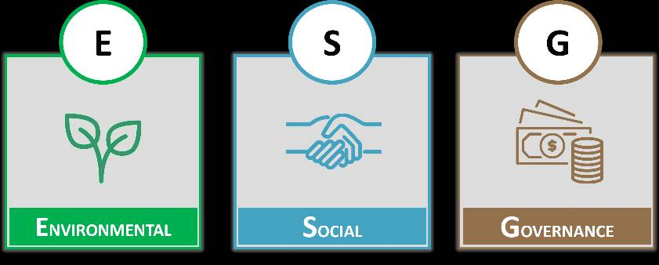
What is ESG?
E – Environmental: manage environmental impact
S – Social: promote social responsibility
G – Governance: ensure transparent, ethical governance
Adapted from corporate sector to cultural organisations

Slide 61
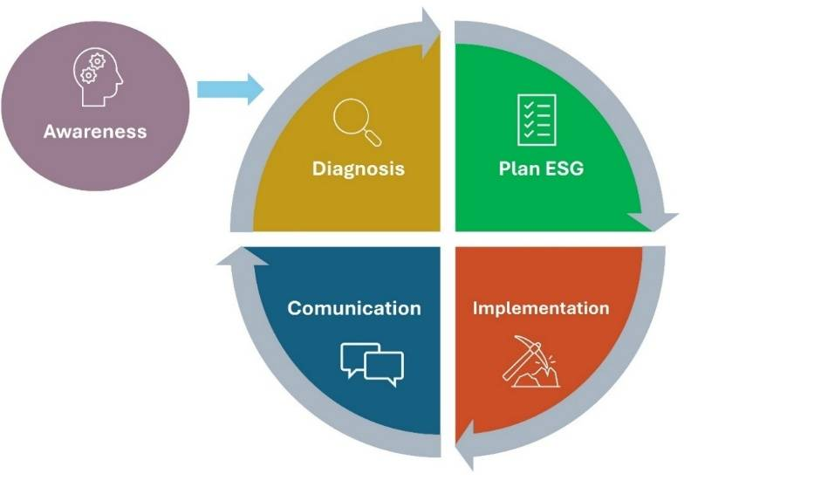
Building an ESG Plan
Roadmap defining sustainability strategy
Environmental: sustainable materials, energy efficiency, waste management
Social: inclusion, diversity, team well-being
Governance: transparent and ethical practices

Slide 62
Purpose of an ESG Plan
Integrate sustainability into strategic planning
Meet expectations of funders, audiences, stakeholders
Identify non-financial risks and opportunities
Align with Sustainable Development Goals (SDGs)
Strengthen reputation and competitiveness

Slide 63
Phases of ESG Plan Development
Phase 0 – Awareness
Phase 1 – Diagnosis
Phase 2 – Planning
Phase 3 – Implementation
Phase 4 – Communication

Slide 64
Sustainability Reporting
Structured document presenting ESG impacts
Goes beyond financial data
Covers energy, diversity, waste, community engagement
Encourages transparency and strengthens culture

Slide 65
Sustainability Reporting Standards
Define impacts to measure, data collection, communication
GRI: widely used, adaptable to cultural sector
EU CSRD: broader scope, mandatory standards (ESRS), double materiality
Helps access funding, partnerships, credibility

Slide 66
Activity C3.A3
Supporting a Theatre to Build Its ESG Plan
Which ESG phase do you think is the hardest for small performing arts organisations to implement and why?
How can trainers help organisations balance creativity with the structured approach that ESG planning requires?

Slide 67
Avoiding Greenwashing
Greenwashing = misleading sustainability claims
Risks: loss of trust, funding, reputation
Proposal for an EU Green Claims Directive: requires verifiable evidence
Be specific, use data, link to recognised frameworks

Slide 68
Chapter 3 Reflection & Key Takeaways
What are your 2–3 key words from this chapter?
Why do these stand out for you?
Share with the group and listen for common threads.
Notes:
Use this moment to consolidate learning from Chapter 2.

Slide 69






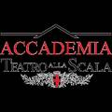





THANK YOU
Funded by the European Union. Views and opinions expressed are however those of the author(s) only and do not necessarily reflect those of the European Union or he European Education and Culture Executive Agency (EACEA.) Neither the European Union nor EACEA can be held responsible for them.
Project Number- 101139932

